Slide 1
The Importance of Multi-tiered Systems to Improve the School Environment and
Support Emotional and Social Development
Susan Barrett, M.A., PBIS National TA Center Michael Lombardo, M.A. Executive Director,
Prevention Services & Supports/PBIS Project Director, Placer County Office of Education
Coordinator, California PBIS Coalition

Slide 2
What we will cover today:
Overview of Positive Behavior Intervention and Supports
What is PBIS and how the Multi-tier Structure of PBIS supports environments for student mental wellness, collaboration and family involvement
Where is PBIS being done Nationally and in California
How the “Interconnected Systems Framework” (ISF) supports a community of collaboration at school districts and sites

Slide 3
U.S. Public Health:
Tiered Logic Model
A few
Cancer treatment; nursing homes; dentures; organ transplants
Some
Medication; medical treatment; fill cavities; vision correction
All
Check-ups; diet; exercise; vaccinations; fluoride; seatbelts
Walker et al. (1996). Integrated approaches to preventing antisocial behavior patterns among school-age children and youth. JEBD, 4, 194 – 209.

Slide 4
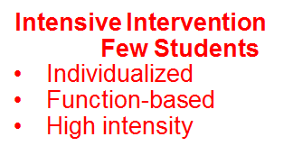
PBIS Framework
Universal Prevention
All Students
Core Instruction
Preventive
Proactive
Common Rules and Expectations
Common Referral System
Strength Based Behavior System
1-5%
7-15%
80%
All students in school

Slide 5
What is PBIS? Positive Behavioral Interventions and Supports
The application of evidence-based strategies and systems to assist schools to improve academic performance, enhance school safety, decrease problem behavior, and establish positive school cultures through a
multi-tiered behavioral framework

Slide 6
PBIS = Implementation Framework
We organize our resources
Multi-Tier Mapping, Gap Analysis
So kids get help early
Actions based on outcomes (data!), not procedures
We do stuff that’s likely to work
Evidence-Based interventions
We provide supports to staff to do it right
Fidelity: Tiered Fidelity Inventory
And make sure they’re successful
Coaching and Support
Progress monitoring and performance feedback
Problem-Solving process
Increasing levels of intensity
Notes:
Problem solving process

Slide 7
Evidence-based features of PBIS
Prevention
Define and teach positive social expectations
Acknowledge positive behavior
Arrange consistent consequences for problem behavior
On-going collection and use of data for decision-making
Continuum of intensive, individual intervention supports
Implementation of the systems that support effective practices

Slide 8
Why PBIS?
The fundamental purpose of PBIS is to make schools more effective, efficient and equitable learning environments.
Predictable
Positive
Consistent
Safe

Slide 9
Experimental Research on PBIS
Bradshaw, C.P., Koth, C.W., Thornton, L.A., & Leaf, P.J. (2009). Altering school climate through school-wide Positive Behavioral Interventions and Supports: Findings from a group-randomized effectiveness trial. Prevention Science, 10(2), 100-115
Bradshaw, C.P., Koth, C.W., Bevans, K.B., Ialongo, N., & Leaf, P.J. (2008). The impact of school-wide Positive Behavioral Interventions and Supports (PBIS) on the organizational health of elementary schools. School Psychology Quarterly, 23(4), 462-473.
Bradshaw, C. P., Mitchell, M. M., & Leaf, P. J. (2010). Examining the effects of School-Wide Positive Behavioral Interventions and Supports on student outcomes: Results from a randomized controlled effectiveness trial in elementary schools. Journal of Positive Behavior Interventions, 12, 133-148.
Bradshaw, C.P., Reinke, W. M., Brown, L. D., Bevans, K.B., & Leaf, P.J. (2008). Implementation of school-wide Positive Behavioral Interventions and Supports (PBIS) in elementary schools: Observations from a randomized trial. Education & Treatment of Children, 31, 1-26.
Bradshaw, C., Waasdorp, T., Leaf. P., (in press). Effects of School-wide positive behavioral interventions and supports on child behavior problems and adjustment. Pediatrics.
Horner, R., Sugai, G., Smolkowski, K., Eber, L., Nakasato, J., Todd, A., & Esperanza, J., (2009). A randomized, wait-list controlled effectiveness trial assessing school-wide positive behavior support in elementary schools. Journal of Positive Behavior Interventions, 11, 133-145.
Horner, R. H., Sugai, G., & Anderson, C. M. (2010). Examining the evidence base for school-wide positive behavior support. Focus on Exceptionality, 42(8), 1-14.
Ross, S. W., Endrulat, N. R., & Horner, R. H. (2012). Adult outcomes of school-wide positive behavior support.
Journal of Positive Behavioral Interventions. 14(2) 118-128.
Waasdorp, T., Bradshaw, C., & Leaf , P., (2012) The Impact of Schoolwide Positive Behavioral Interventions and
Supports on Bullying and Peer Rejection: A Randomized Controlled Effectiveness Trial. Archive of
Pediatric Adolescent Medicine. 2012;166(2):149-156
PBIS Experimentally Related to:
Reduction in problem behavior
Increased academic performance
Improved perception of safety
Reduction in bullying behaviors
Improved organizational efficiency
Reduction in staff turnover
Increased perception of teacher efficacy
Improved Social Emotional competence

Slide 10
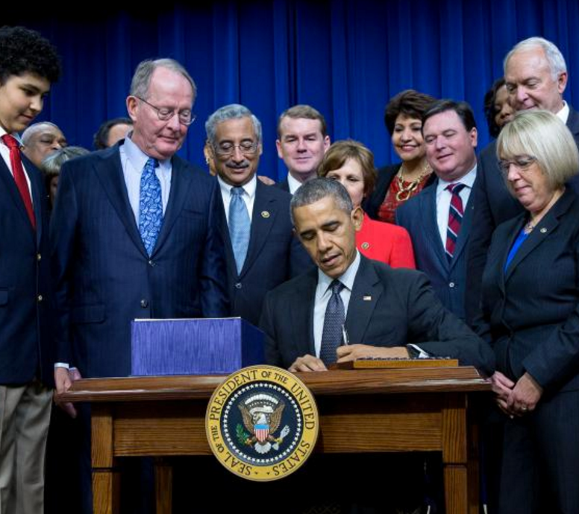
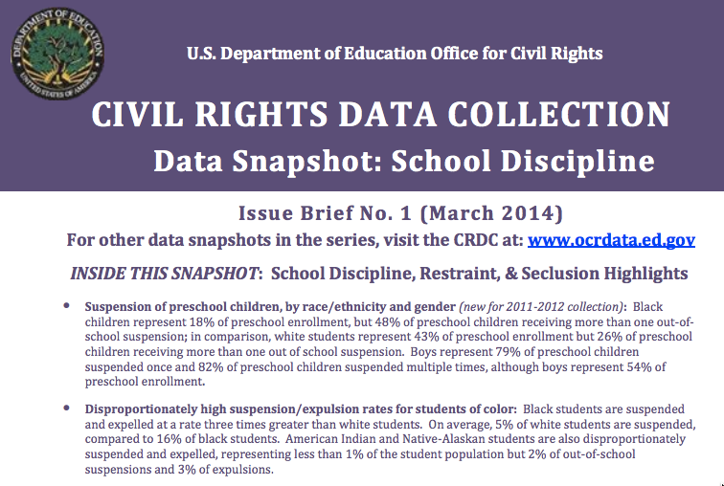
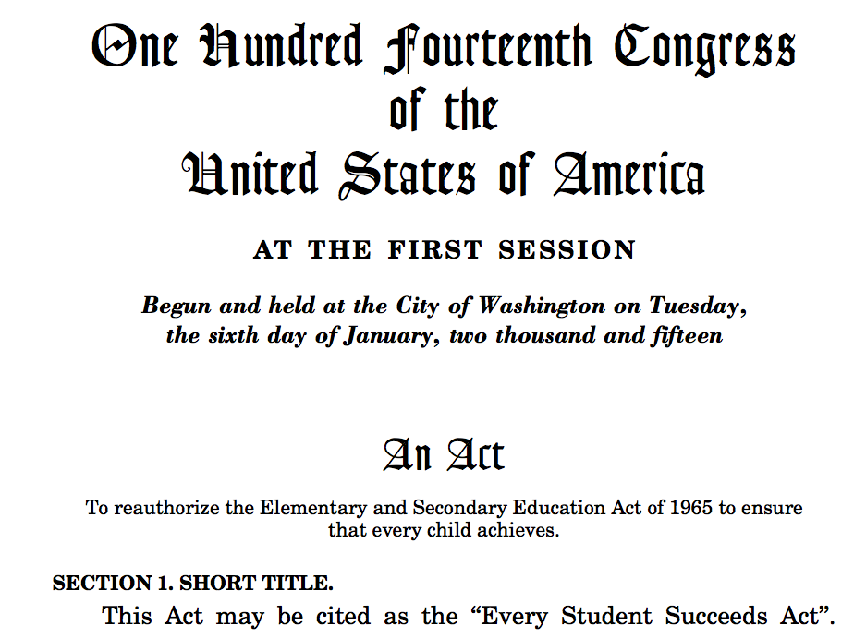
School Violence &
Mental Health
School Climate & Discipline
Individuals with Disabilities Education Act
Every Student
Succeeds Act
Disproportionality & School-Prison Pipeline

Slide 11
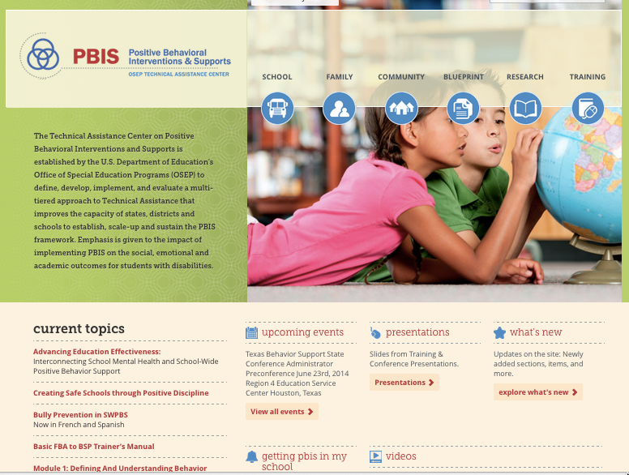
www.pbis.org
New Materials

Slide 12
PBIS Nationally & California

Slide 13
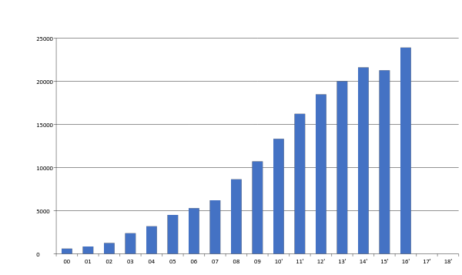
Schools Using PBIS Nationally - January, 2017
24,312 Schools Implementing PBIS
---------------------------
11,958,000 Students
3138 High Schools
Notes:
98,271 in the united states
about 25% of schools in the US are implementing PBIS

Slide 14
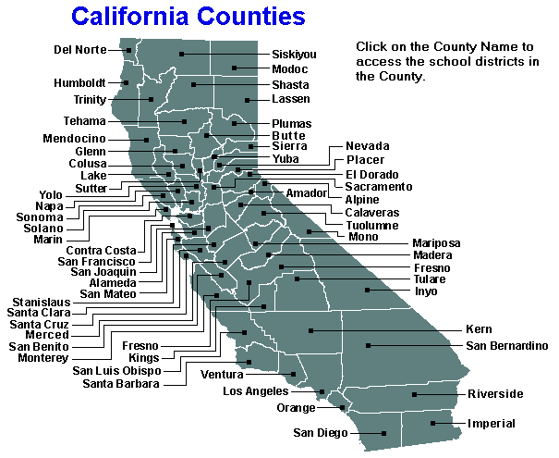
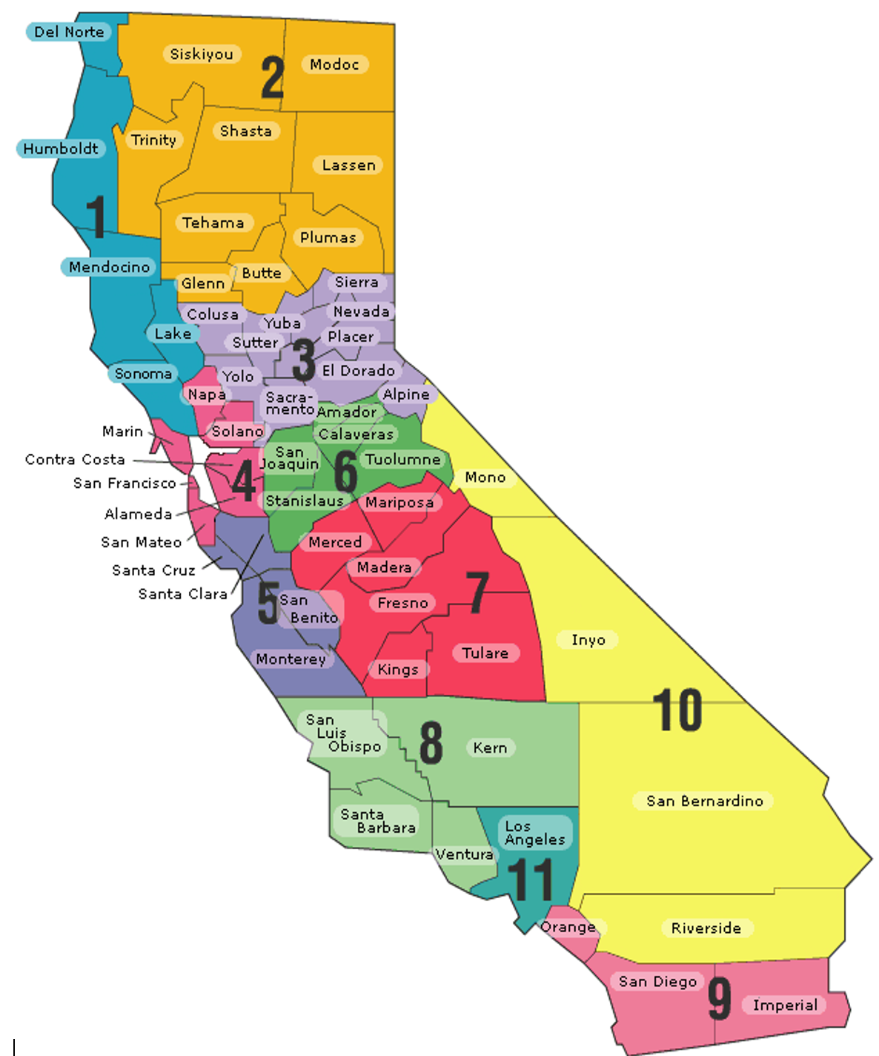
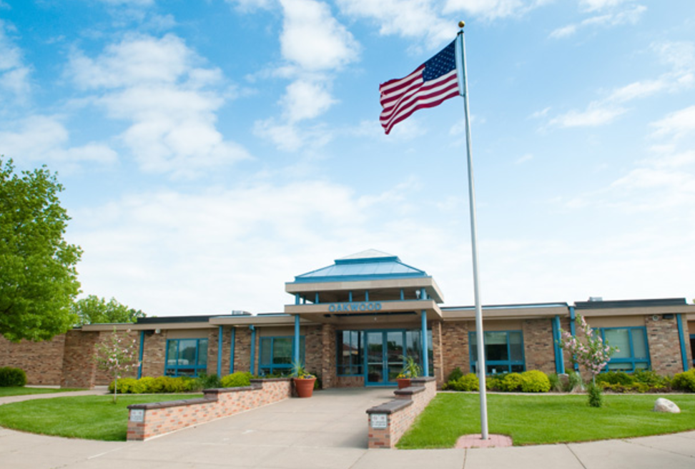
Who’s Implementing PBIS in California
State Level | County Office | District Level | School Level
1,100 Districts
(Within 11 Regions)
58 Counties
10,393 Schools
6.3 Million Students
11 TA Centers
25 school districts account for approximately 30% of this enrollment number
Notes:
Mike

Slide 15
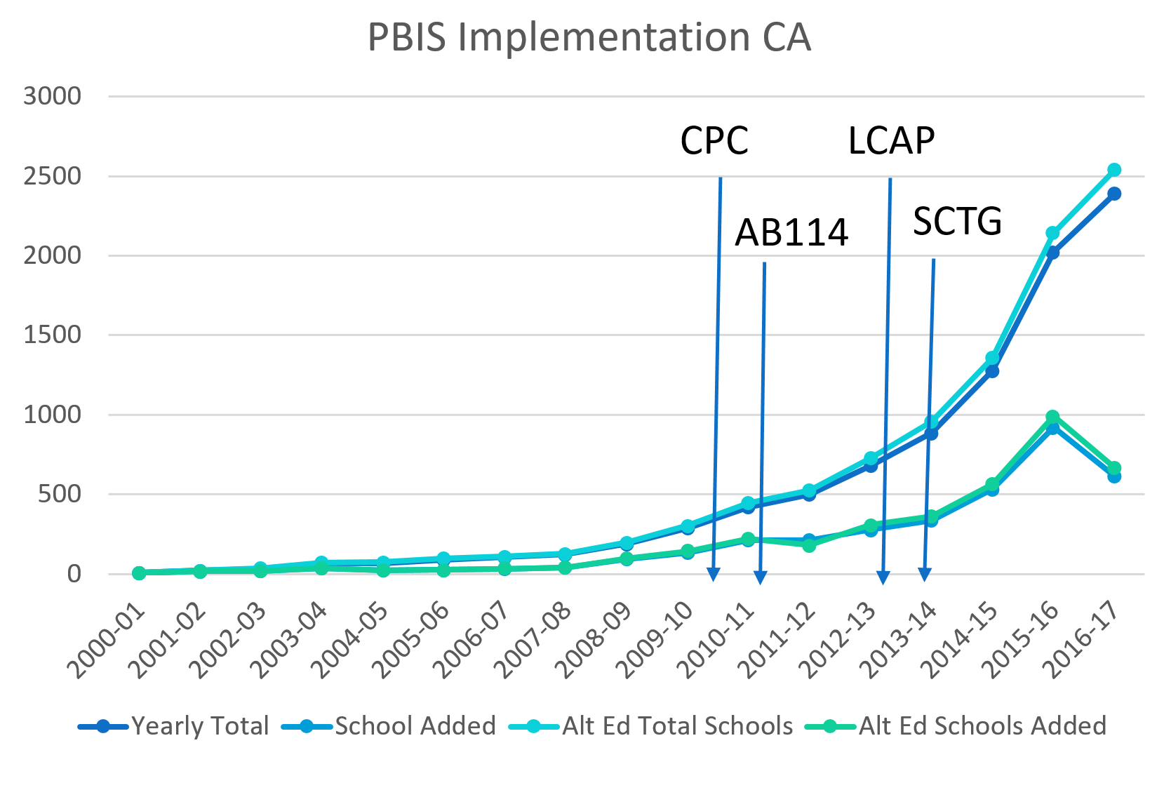

Slide 16
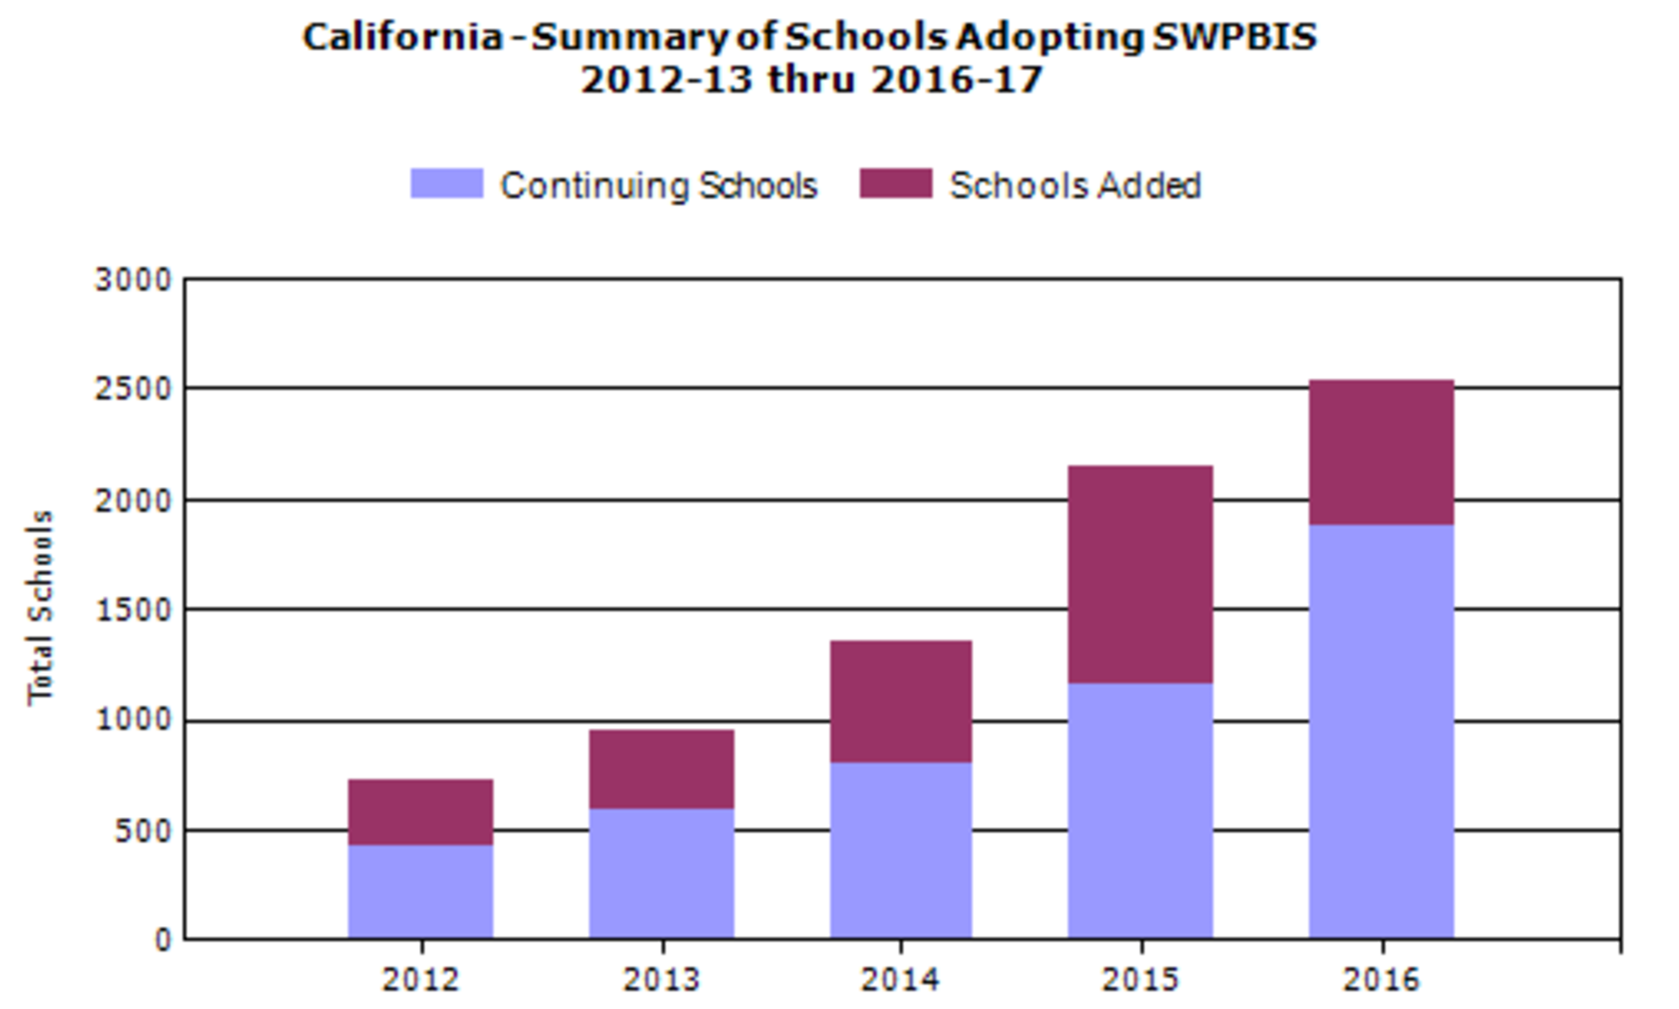
Schools are adopting and persisting at PBIS Implementation

Slide 17
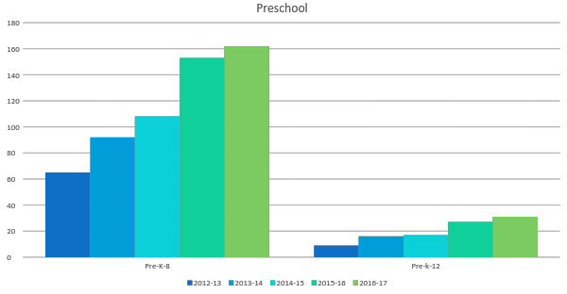
Preschool PBIS Implementation 2012- 2017
Pre K - 8
Pre K - 12

Slide 18
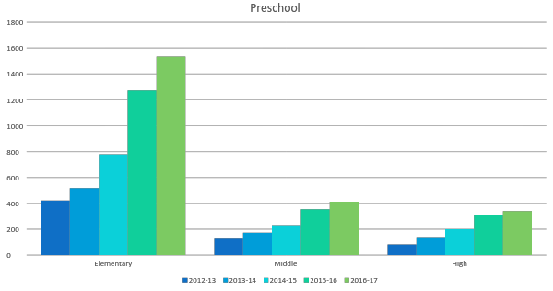
Elementary Middle and High School
PBIS 2012 - 2017
Now in California some Elementary will also include Transitional Kindergarten (T-K), but not all elementary schools have T-K.
Elementary
Middle
High

Slide 19
Tier Fidelity Inventory
(TFI) initial assessment to determine the extent to which a school is using (or needs) PBIS
70% or better school indicates a school has the systems in place to achieve and sustain outcomes
Assessment to measure implementation at all three tiers of support, and a tool to guide action planning for further implementation efforts
Evaluation of TFI Showed
Strong construct validity for assessing fidelity at all three tiers
High usability for action planning
Strong relations with existing PBIS fidelity measures.
Implications for accurate evaluation planning are discussed.

Slide 20
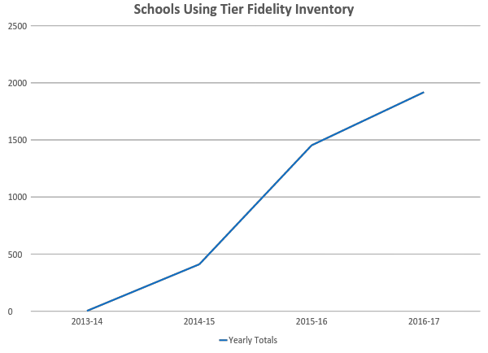
Schools Using the Tier Fidelity Inventory
Almost all schools adopting PBIS are now using the TFI

Slide 21
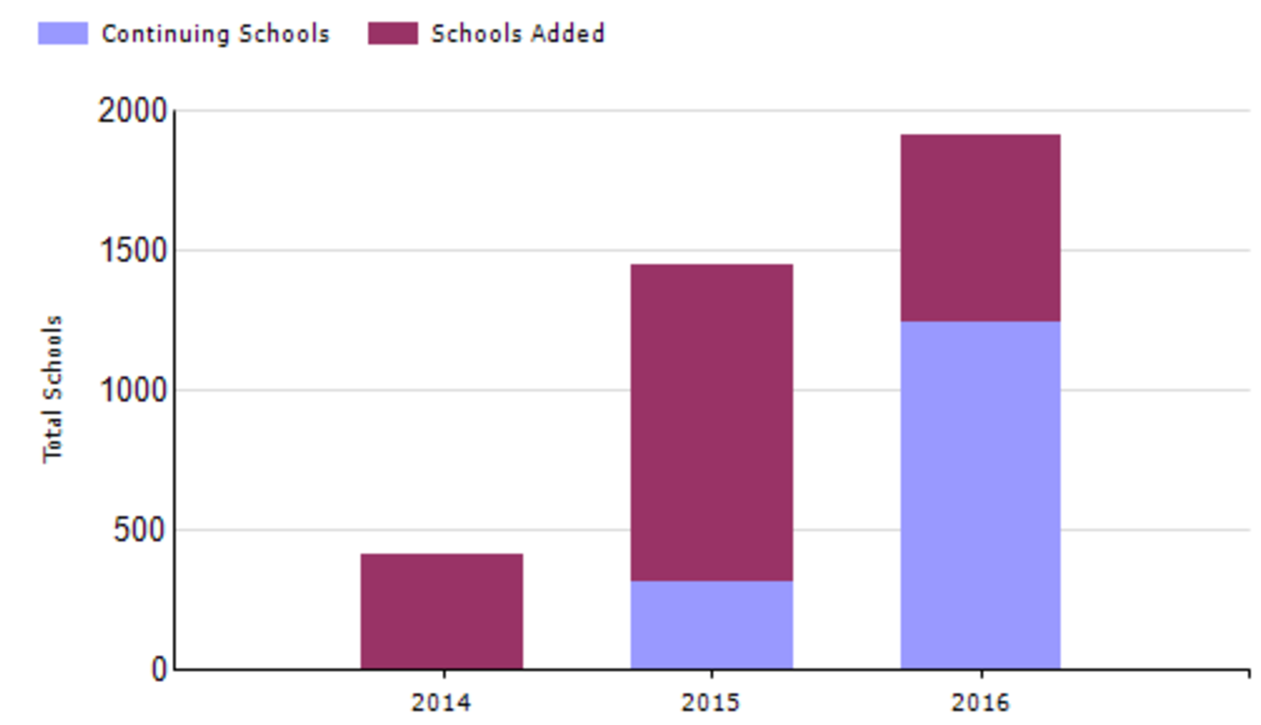
Summary of Schools Using TFI

Slide 22
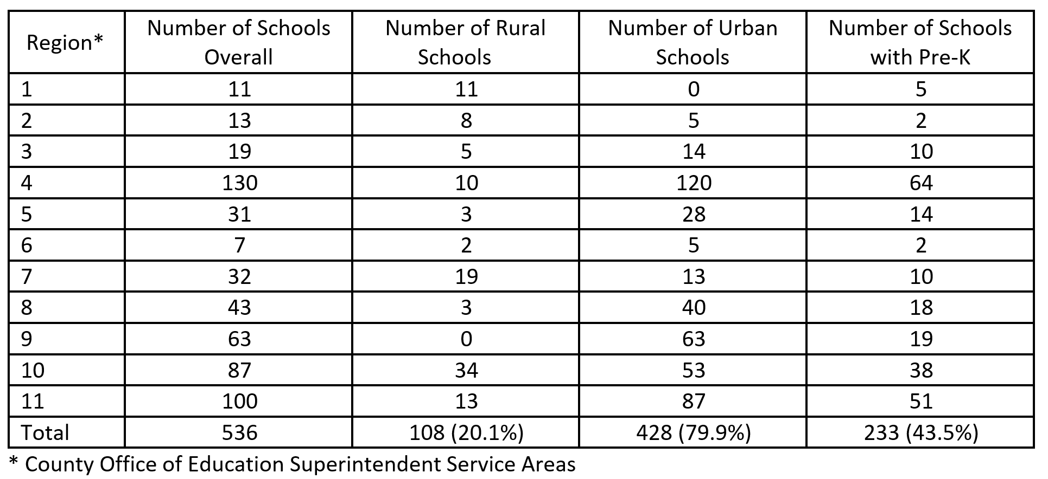
California Elementary Schools Achieving PBIS Tier 1 Fidelity by County Superintendent of Schools Regions Overall and by Rural or Urban Area

Slide 23
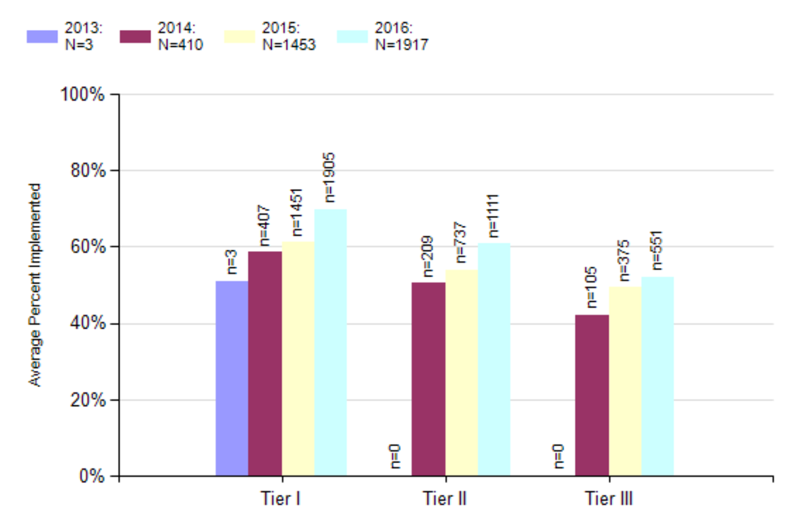
Are California Schools Implementing With Fidelity
Schools implementing at 70% or better experience outcomes indicated by evidence.

Slide 24
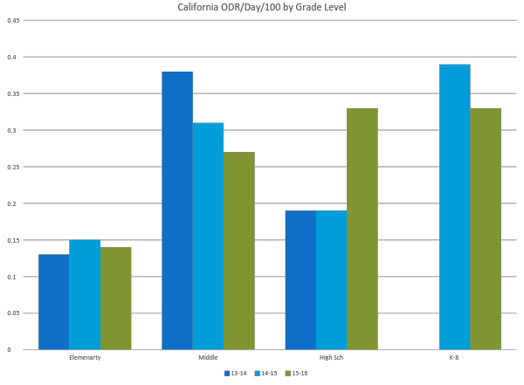
California Office Referral – Day / 100 Students
National Average
n~130
n~72
n~62
n~463
Elementary
Middle
High
K - 8
Notes:
Points to Note from Rob:
1. Looking at ODR rates for over 400 schools in California implementing PBIS, they are not only demonstrating success in implementing Tier I PBIS practices, but their rate of office discipline referrals is below national norms (and stable at that low level). Schools using PBIS are creating a positive social culture in their schools, and this shows up in student behavior.
2. The most impressive result to date is with the 130 middle schools that more recently adopted PBIS. They have documented a 33% reduction in rate of ODRs as they have adopted PBIS>
3. There are a smaller number of high schools using PBIS, and recent adoptions have been linked to increased ODR rate, but even with the increase California schools are at the national norm.
4. PreK-8 schools are showing positive trend.

Slide 25
National Climate Change & Need to “double-down” on Prevention

Slide 26
Partnerships & Collaboration are needed:
One in 5 youth have a MH “condition”
About 80% of those get no treatment
School is “defacto” MH provider
Juvenile Justice system is next level of system default
Suicide is 2nd leading cause of death among young adults
Factors that impact mental health occur ‘round the clock’
It is challenging for educators to address the factors beyond school
It is challenging for community providers to address the factors in school

Slide 27
ISF=Multi- Tiered System of Support Whole Child and Whole School Community
Equal Priority: Social Emotional Skills and Academic Skills Essential Public Health Approach:
Educators, Community Providers, Family, Students work together to review data and build a personalized community plan
Foster Care and Connections with ALL children and youth
Identify early and intervene with evidence based practices that lead to improvements in student functioning
Support staff to implement with fidelity
Monitor and adapt throughout the process

Slide 28
An Interconnected Systems Framework (ISF) Defined
A Structure and process for education and mental health systems to interact in most effective and efficient way.
guided by key stakeholders in education and mental health/community systems, youth/family
who have the authority to reallocate resources, change role and function of staff, and change policy.

Slide 29
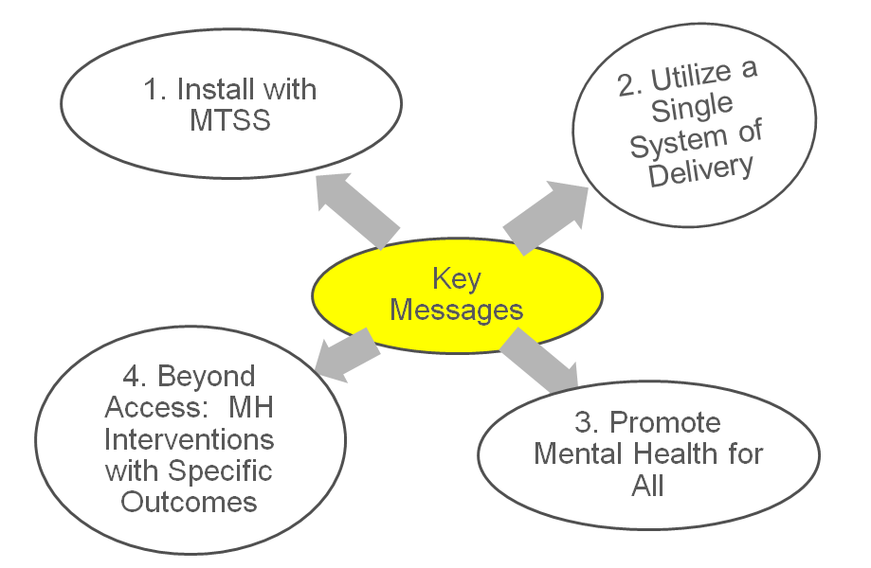

Slide 30
ISF Core Features
Effective teams that include community mental health providers
Data-based decision making
Formal processes for the selection & implementation of evidence-based practices (EBP)
Early access through use of comprehensive screening
Rigorous progress-monitoring for both fidelity & effectiveness
Ongoing coaching at both the systems & practices level
Notes:
Quick review
Same as PBIS RTI MTSS (labels not as important as ensuring core features needed for installing EBPs)

Slide 31
Traditional
An Interconnected Systems Framework
MH counselor “sees” student at appointments
MH person on teams at all tiers. Interventions are defined (core features, dosage. Frequency, outcomes)
Clinicians only do “mental health”
MH is everyone’s job. Clinicians contribute to integrated plan
Case management notes
Fidelity AND outcome data determined before delivery; data monitored continuously by teams

Slide 32
Advancing Education Effectiveness: Interconnecting School Mental Health and
School-Wide Positive Behavior Support
Editors: Susan Barrett,
Lucille Eber and Mark Weist
pbis.org
csmh.umaryland
IDEA Partnership NASDSE

Slide 33
ISF Sites
Florida (LEAs)
South Carolina (LEAs)
Pennsylvania (LEAs)
California (Regions)
North Carolina (LEAs)
Virginia
Georgia (State)
New Hampshire (State)
Illinois (LEAs)
Iowa (State)
Kentucky (State)
Wisconsin (State)
Notes:
knowledge development/demo sites share data regarding implementation progress

Slide 34
Questions
Susan Barrett, M.A., PBIS National TA Center
sbarrett@midatlanticpbis.org
Michael Lombardo, M.A. Executive Director,
Prevention Services & Supports/PBIS Project Director, Placer County Office of Education
Coordinator, California PBIS Coalition
mlombardo@placercoe.k12.ca.us

