Slide 1
UNCONDITIONAL EDUCATION
GRANT ELEMENTARY SCHOOL

Slide 2
GRANT ELEMENTARY
Kindergarten through 6th grade
500 students served
89.9% FRPL
88% Latino, 6% Black
90% English Language Learners

Slide 3
UNCONDITIONAL EDCUATION

Slide 4
WHAT’S DIFFERENT
TRADITIONAL
APPROACH
UNCONDITIONAL
EDUCATION
Services and service providers are siloed and separate
Special Education staff and Clinicians are responsible for providing interventions to students
Students must fall far behind in order to receive extra support
Services and service providers are integrated and coordinated
Expert staff work to build the capacity of the entire community to provide interventions with students
Data-driven progress monitoring is employed to identify students before they fail

Slide 5
ROLE OF THE COACH

Slide 6
MULTIDISCIPLINARY
TRANSDISCIPLINARY
Members use their individual expertise to develop their own answers to a given problem and then come together to formulate a coordinated solution
Members rely solely upon expertise and methods from their own discipline
Members engage in professional development related only to their own discipline
Members work together from the beginning, and collaboratively develop solutions to problems
Members develop and combine methods from multiple disciplines to develop innovative solutions
Members learn from each other and engage in cross-disciplinary learning

Slide 7
COORDINATION OF SERVICES

Slide 8
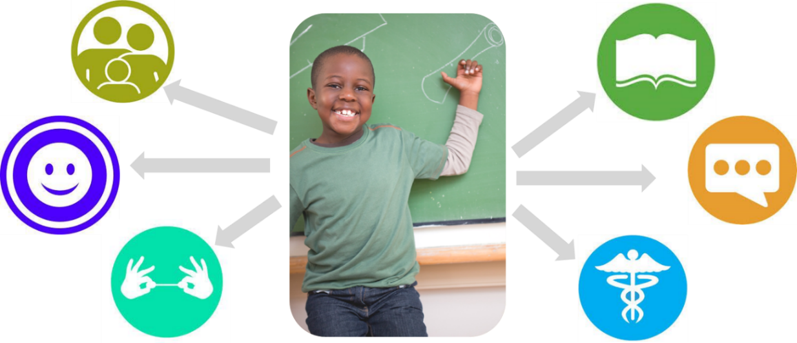
BEFORE
AFTER
Notes:
BEFORE:
Academic referrals looked more like a traditional Student Support Team process
Meetings were scheduled upon request and viewed as the first step toward IEP assessment
Referrals for behavior/social emotional needs went directly to onsite clinician
Coordination providers did not have a regular time to meet and teachers had little access to special education and mental health expertise
AFTER
COST team facilitated by UE Coach and consisting of admin, special education, mental health providers meets twice monthly to review data and student referrals
Universal referral form for any need
Provided subs to rotate out teachers who made referral so they could be at the table. Present their challenges, receive insight and professional development from experts, collaboratively decide on next steps
Eventually instituted a “COST consultation” as a pre-step
IMPACT:
47 Meetings held
13 staff supported
53 student referrals reviewed
On an end of year survey, over 80% of staff said that they know the process for referring a student for academic, behavioral, and social emotional support and 70% of staff agreed that these supports are well-coordinated

Slide 9
COORDINATION OF SERVICES
“Coordinated" means: Teachers, administrators, and support providers work together to create a common understanding of students' needs, to connect students to appropriate services, and to set goals and track outcomes. Each do their part, avoiding redundancies and gaps in service.
TEAM MEMBERS:
Administrators
General Education Teacher
Speech Pathologist
Instructional Coach
Community Providers
School Psychologist
Family
Counselor
Academic Interventionist
Seneca Coach

Slide 10
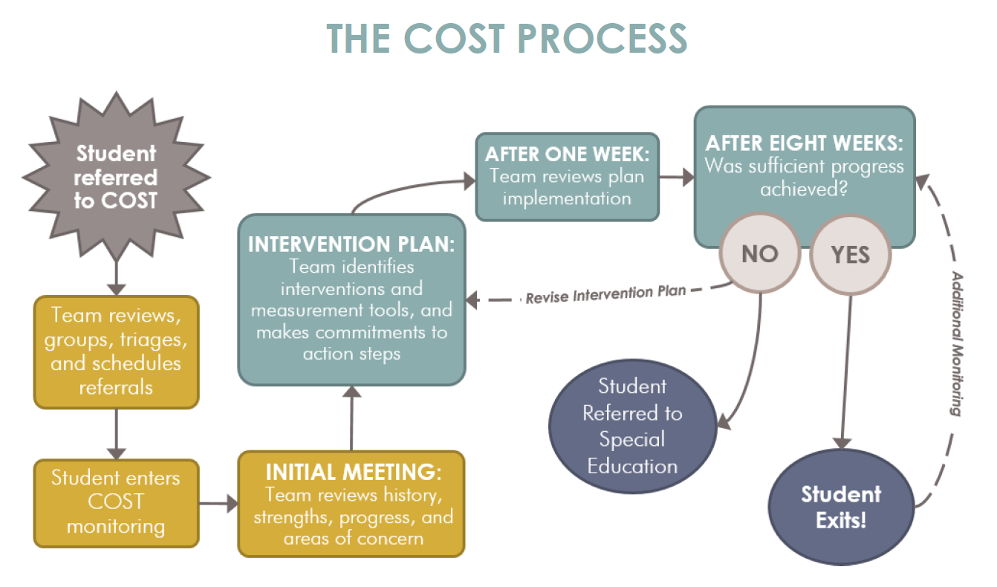
COORDINATION OF SERVICES TEAM PROCESS

Slide 11
IMPACT OF COST PROCESS
83% of staff feel knowledgeable about the process to seek student support
70% of staff believe services are coordinated
85% of staff believe the COST team is responsive to student needs
85% of staff believe that student support services are effective

Slide 12
TIER TWO

Slide 13
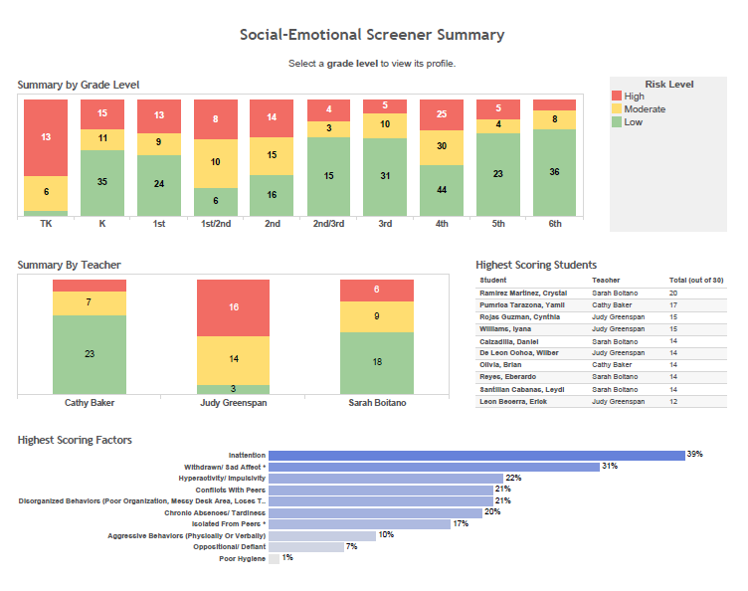
BEFORE
AFTER
Notes:
BEFORE:
No tier two services
EPSDT Clinician had 13 slots for traditional outpatient therapy – could not meet demand
Served externalizers
AFTER
Implemented school-wide social emotional screener
Worked with COST, including EPSTD clinical and district school psych to identify classrooms and students in need
Proactively created social skills groups and split up caseload based on our expertise
Included groups for internalizers experiencing anxiety
IMPACT
38 students served in social skills groups and/or CICO (7% of students)

Slide 14
IMPACT OF SCREENER AND MENTAL HEALTH TEAM
Additional 38 students received Tier 2 supports
80% of teachers report that their students received social emotional support
70% of teachers report that students showed growth after behavioral services
92% of teachers report that providers help implement classroom interventions

Slide 15
CUTLTURE AND CLIMATE

Slide 16
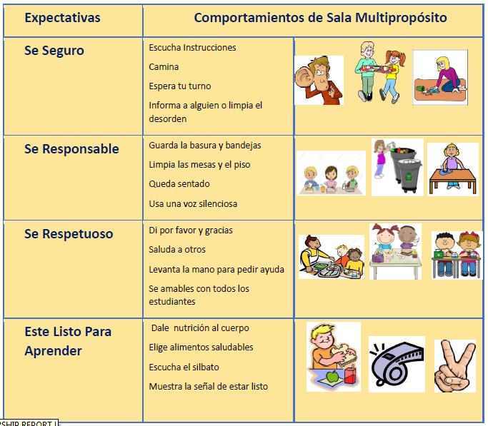
BEFORE
AFTER
Be Safe
Be Respectful
Be Responsible
Be Ready to Learn
Notes:
One example of a culture and climate initiative was PBIS
BEFORE:
Had 3 B’s
No structure or reinforcement
AFTER:
PBIS foundation training for staff
Developed matrix for each space and explicitly taught expectations
Formalized recognition system
Developed discipline flowchart and rolled out to staff
Next step next year: roll out office discipline referral system and SWIS to regularly reflect on data for decision making
IMPACT:
Increased PBIS tiered one fidelity by
Increased sense amongst staff that we have a consistent discipline practice and use positive interventions to behavior (SCAI)

Slide 17
IMPACT OF PBIS INTERVENTIONS
80% of staff feel satisfied with community unity
Staff report a score of 4.04 (out of 5) on school’s focus on behavior
Staff report a score of 4.16 (out of 5) on consistent discipline practices
Staff report a score of 4.25 (out of 5) on positive behavior interventions

Slide 18
THANK YOU!

