Slide 1
Prevention and Early Intervention
Diana A. Brown, MS LMFT LPCC
Administrative Services Manager

Slide 2
Building Partnerships Across Schools and Community Agencies

Slide 3
PROGRAMS
Preschool 0-5 programs, Prevention & Early
Intervention Mobile Services
Cognitive Behavioral Intervention for
Trauma in Schools (CBITS)
Olweus Bullying Prevention Program (OBPP)
Positive Parenting Program (Triple P)
Strengthening Families Program (SFP)

Slide 4
Prevention & Early Intervention Mobile Services
For families w/ children who exhibit chronic
disruptive behaviors at home, in school,
preschool or daycare.
Services are provided in mobile clinics.
Services include:
PCIT
Incredible Years
Strong Kids group
TCIT
Parent and Staff consultations
TFCBT

Slide 5
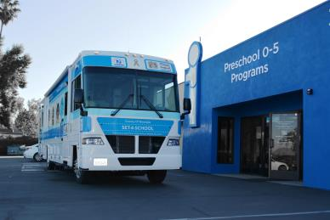
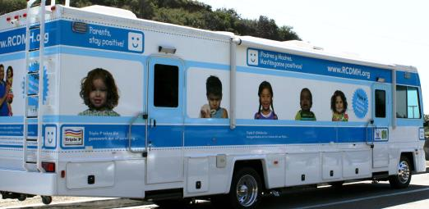
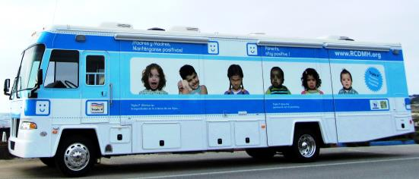

Slide 6
Cognitive Behavioral Intervention for Trauma in Schools (CBITS)
A 10-week program designed to address
symptoms youth develop from traumatic
events
Aims to – Reduce PTSD symptoms while
Enhancing coping skills
Increasing resiliency
Raising peer/parent support

Slide 7
Cognitive Behavioral Intervention for Trauma in Schools (CBITS)
CBITS uses Cognitive-Behavioral techniques including:
Psycho-Education
Relaxation
Social Problem Solving
Cognitive Restructuring
Exposure

Slide 8
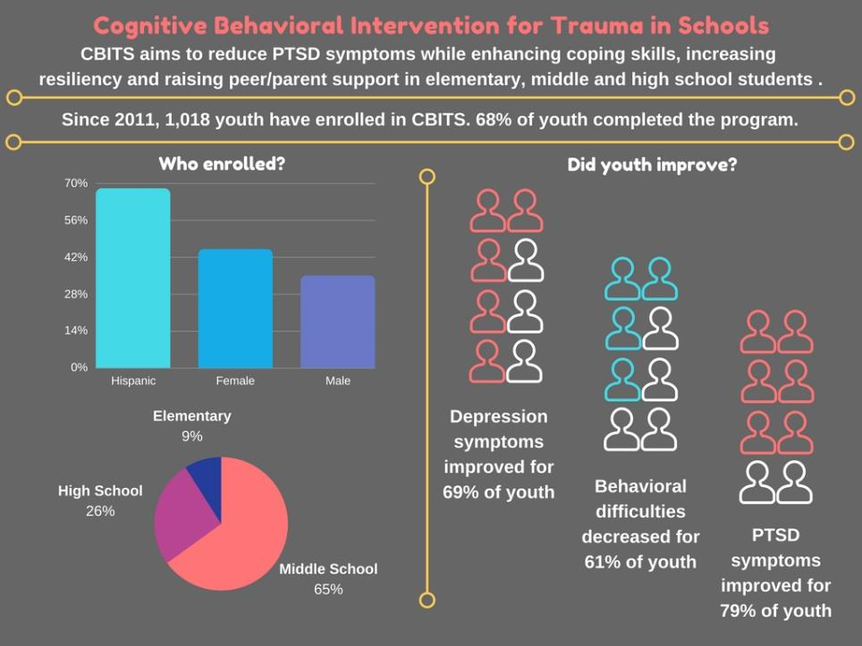

Slide 9
Olweus Bullying Prevention Program (OBPP)
Most researched and best known bullying prevention program available
In partnership with Riverside County Office of Education (RCOE)
OBPP is conducted at schools, classroom and on individual levels
Includes methods to reach out to parents and community for involvement & support
Goals
Reduce existing bullying problems
Prevent development of new bullying problems
Achieve better peer relations at school

Slide 10
Positive Parenting Program (Triple P)
Parenting and family support system designed to
prevent – as well as treat – behavioral and emotional
problems in children and teenagers.
Aims to –
Prevent problems in the family, school and community before they arise
Create family environments that encourage children
to realize their potential

Slide 11
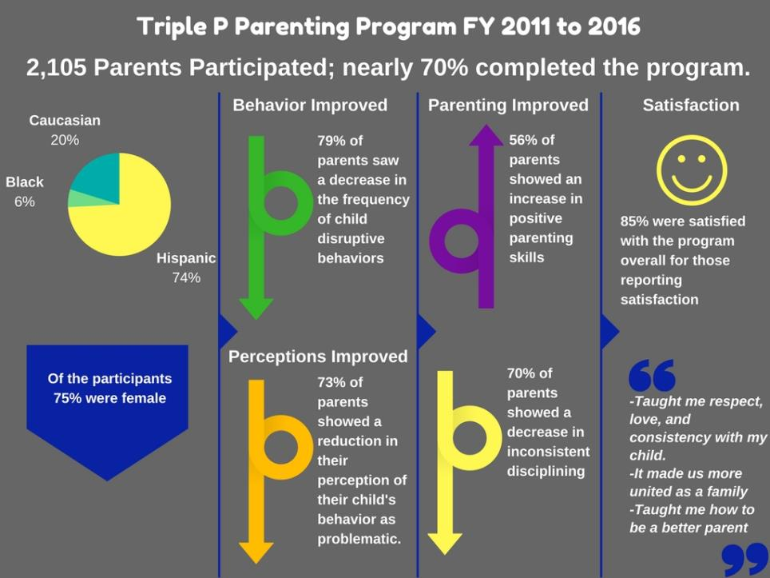

Slide 12
Strengthening Families Program (SFP)
14 – Session Evidence-based family skills training program
Nationally and internationally recognized parenting and family strengthening program for high-risk and general population families.
Services Parents & Children ages 6-11

Slide 13
Strengthening Families Program (SFP)
SFP has proven to significantly improve –
Parenting skills and family relationships
Reduce problem behaviors, delinquency and
alcohol and drug abuse in children
Improve social competencies and school
performance
Decrease child maltreatment as parents
strengthen bonds with their children and learn
more effective parenting skills

Slide 15
Services conducted on school campuses allow:
Greater access to youth
Higher completion rates
Reduction of stigma receiving services

Slide 16
Common Barriers / Challenges
Logistics
Obtaining access to consistent school space
Availability of facilities to hold evening programming
Staff
Turnover in school staff
Training – new staff is a challenge
Different Focus
Schools are academics vs. Behavioral Health’s focus on social emotional needs, family systems, etc.

Slide 17
Key Elements for Partnerships
Established Relationships between CBOs and School’s Administration
Ongoing Communication
School Staff Engagement
Interaction

Slide 18
Partnership in Action
Through the eyes of a Triple P provider:
Cristina Jennings, Parent Education Coordinator, The Carolyn E. Wylie Center

