Slide 1
First 5 Partnerships & Insights in School-Based Early Mental Health
June 30, 2017

Slide 2
Presentation Overview
Experiences from the early mental health and prevention field:
Power of partnerships
Social emotional health/ Intensive intervention
Early identification and screening
Family engagement
Challenges and opportunities of early prevention

Slide 3
Today’s Presenters
Margot Grant Gould, First 5 Association
Tammi Graham, First 5 Riverside
Adria Galarza, Lake Elsinore Unified School District
Melinda Konoske, Children & Families Commission of Orange County
Malia Ramler, First 5 Alameda

Slide 4
First 5 Riverside &
Lake Elsinore Unified School District

Slide 5
Power of Partnerships
Mental health is multi-faceted
Everyone plays a role in addressing needs
Riverside’s leveraged funding model
Set-4-School System and SNAP
SERVICES PROVIDED
Parenting Classes
Positive Parenting Tip Sheets
Preschool teacher support and training
Early Childhood Assessments
Parent Child Interaction Therapy (PCIT)
Help for children and families who have experienced traumatic events

Slide 6
Investment in Behavioral Health FY 11/12 – FY 17/18
$9,296,857
TOTAL $19,403,774
$10,106,917

Slide 7
Riverside’s Leveraged Funding Model
First 5 Riverside
SET-4-School Program
Fiscal Year 2016 - 2017
Administration
RUHS - Behavioral Health | $ 439,000
RUHS - Public Health | $ 10,000
Community Based Partners | $ 270,000
Lake Elsinore USD SNAP | $ 482,000
Administration | $ 49,000
Total First 5 Riverside Funding | $ 1,250,000
Community Based Partners
Lake Elsinore USD
RUHS – Behavioral Health
Leveraged Funding (in addition to above dollars)
RUHS - BH MHSA $500,000
RUHS – BH Medi-Cal $500,000
RUHS – Public Health
Total for Set-4-School Program | $ 2,250,000
* Behavioral Health, Public Health and 4 other partner school districts all make additional in kind contributions. LEUSD’s in kind contribution is $2 million over a 12-year period

Slide 8
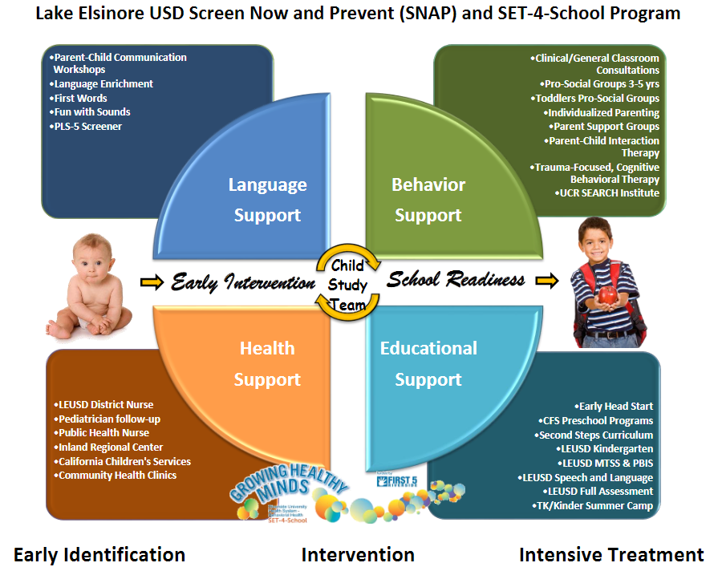
Pre-referral interventions, early identification & integration to services

Slide 9
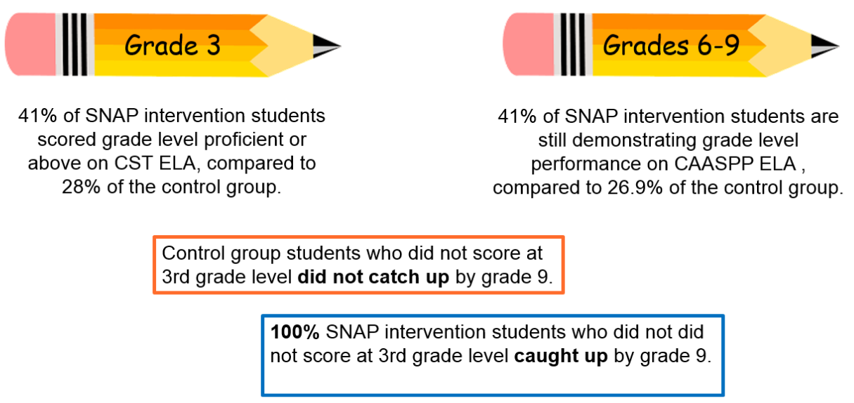
What Success Looks Like
10-year follow-up academic and cost benefit study
Pre-referral interventions, early identification & integration to services

Slide 10
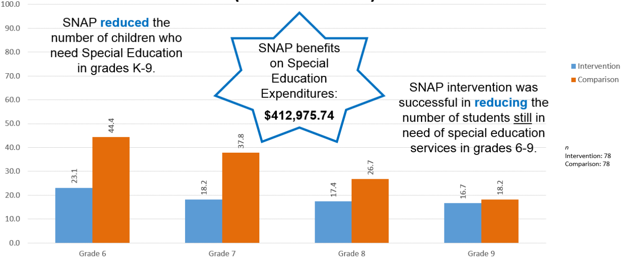
What Success Looks Like
10-year follow-up academic and cost benefit study
Pre-referral interventions, early identification & integration to services

Slide 11
Power of Partnerships

Slide 12
Children & Families Commission of Orange County

Slide 13
Experiences of Early Childhood Education Providers
Key Findings in Orange County¹:
Over 1/4 (28%) of early education providers have behavior or mental health concerns about a child they serve
More than 1/3 (37%) of providers have asked a child to leave their program permanently due to behavioral challenges/ potential mental health concerns
Nearly 1/4 (22%) of providers were caring for a child who had been asked to leave their previous provider for behavior or mental health concerns.
¹ Survey conducted by the CSU Fullerton Social Science Research Center, with support and funding provided by the Orange County Early Childhood Mental Health Collaborative members and the Children and Families Commission of Orange County.

Slide 14
Experiences of Early Childhood Education Providers
Key Findings in Orange County:
79% Center-Based vs. 44% Family Child Care staff trained to address behavior and mental health concerns.
Site visits rated as one of the most useful forms of training. Yet, only 46% had received a site visit by some type of specialist, and less than 20% of those specialists were specifically for behavior or psychological services.
The receipt of special education training was positively related to the number of children being cared for.

Slide 15
Survey Analysis: Child Care Providers
Child care providers recognize troubling behaviors early; but children typically do not have a diagnosis to qualify for services
Coaching models are effective towards supporting the provider’s ability to serve individual children
The most appropriate care environment for the individual child must be considered; support is needed for a variety of provider types
Providers want to serve children with mental health conditions, but experience a lack of consistent resources

Slide 16
Parent Interviews and Experiences
Awareness and understanding of appropriate child behavior and development
Importance of and opportunities within the parent/teacher relationship
Reducing the stigma of challenging behaviors and mental health conditions
Introducing services in a familiar and routine environment
Barriers including financial qualifications, health qualifications, transportation

Slide 17
Orange County Pilot Program
Goals of Pilot:
Reduce preschool suspension & expulsions
Increase early education capacity
Increase earlier identification
Connect to parents
Pilot Participants:
Licensed centers, licensed family child care homes
Location “hot spots”
Desire to participate
Establishing a Network
Child age 0-8 who:
Exhibited challenging behavior without a diagnosis OR
Have a diagnosis but deemed ineligible for services that would support their behavior in the classroom

Slide 18
Orange County Pilot Program
Systems development/ integration:
Help Me Grow → developmental screenings
Children’s Hospital of Orange County → clinical services
Community organizations → behavior interventions, parent education, social services
Key Components:
On-Site Consultation & Coaching
Provider & Parent Education
Referrals
Direct Clinical Assessment & Services

Slide 19
First 5 Alameda

Slide 20
Unique Context of ECE
Kindergarten teachers know what research reinforces:
social emotional self-regulation = ready to learn
Early care and education (ECE) ideal for social emotional learning and early identification of mental health concerns.
But must be delivered in the unique context that is ECE – Lessons learned in Alameda County:
Many pathways to kindergarten
ECE Workforce Characteristics
Need for developmental specificity

Slide 21
1) Many Pathways to Kindergarten
Unlike 1st -12th grade, early learning is not required
40% of our 3-5 year olds don’t attend licensed care
State ECE subsidy in many settings:
School district CDC’s
CBO’s
FCC and FFN
Private child care centers
Key Takeaways:
Engage families to increase access to and utilization of formal early learning;
Look beyond just local education agencies to all state supported preschool settings

Slide 22
2) ECE Workforce Characteristics
Some “givens” in the K-12 system may not apply in ECE – even when it is a school district classroom
Schedules
Compensation
Credentialing
Key Takeaways: Funding for schoolwide climate interventions need to allow for flexible use of:
Training, coaching, and release time
Differently credentialed mental health workers
Support for “job crafting” and pay parity

Slide 23
3) Developmental Specificity
Lower expulsion rates when teachers report having access to mental health consultation. Includes:
Classroom consultation
Individual child consultation
Early childhood mental health consultants are cross trained in both early childhood mental health, child development, and ECE practice
California Department of Ed has invested in a positive behavior support model specific to early learning – CA CSEFEL – in alignment with PBIS

Slide 24
Key Takeaways
Program Alignment & Partnership Opportunities:
QRIS - Professional development pathways for ECE providers and promotes ASQ/ developmental screening; In all 58 counties
Help Me Grow – Resource referrals for developmental screenings and parent education. Currently in 15 counties and expanding.
Unique Insights for ECE
Array of pathways Kindergarten – family engagement critical
PreK workforce differences
Developmentally specific evidence based models – like CSEFEL and ECMHC – are consistent with PBIS.
Partnerships and Leveraged Funding
What makes programs possible and successful
Blended funding streams are the norm; sustainability is the challenge
First 5 wants to be partner as you move forward with your pilot
Continued Coordination
Trainings and professional development
Shared finding of existing programs (Lake Elsinore USD) and newly created pilots (Orange County)

Slide 25
Thank You
&
Question?

