Slide 1



Behavioral Health
Office of Innovation
Inland Empire PsychPartners: Public-Private Collaboration to Transform Emergency Psychiatric Services (I.E. PsychPartners)
San Bernardino and Riverside Counties
November 16, 2017
Artwork by Sheila Dery
www.SBCounty.gov

Slide 2
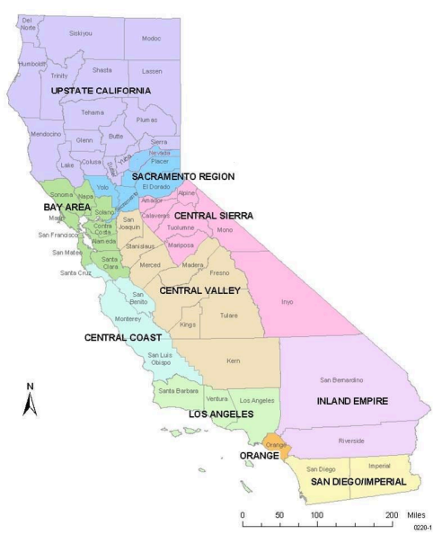


Inland Empire
San Bernardino
Inland Empire
Riverside
27,000 square miles
Population of 4 million
Mix of suburban and rural areas
36 Emergency Departments
Behavioral Health
www.SBCounty.gov

Slide 3
Project Overview
Goal: The project seeks to effect system-wide transformative change by modifying the ways in which the hospital system interacts with the public behavioral health system in the care of patients seeking psychiatric emergency services in hospital Emergency Departments (ED).
  I.E. PsychPartners will construct a collaborative infrastructure to increase quality of services, which includes better outcomes, by introducing a two county (regional) approach to the management and organization of behavioral health consultation services into a regional collaborative approach.
Primary Purpose: To support medical decision making in the ED with telehealth psychiatric consults and behavioral health nurse support, thereby improving access to care for individuals experiencing a psychiatric crisis in EDs.
Learning Objective: To learn how to improve ED behavioral health visits through interagency collaboration and the integration of behavioral health specialists and existing technology.
Behavioral Health
www.SBCounty.gov

Slide 4
What Does the Research Say?
  San Bernardino County has a total of 18 Emergency Departments (EDs), all of which have experienced increases in individuals experiencing psychiatric crisis (2011-2014). (OSHPD)
  According to a National Study by Harvard University, California had an average wait time of 5.6 hours in the ED, in comparison psychiatric patients spend an average of 11.5 hours in the ED prior to receiving appropriate behavioral health care treatment and referral services.
  Telepsychiatry has the ability to use technology in order to extend the workforce, provide convenience of services, increase access, improve consumer adherence with therapy, and improve the overall quality and continuity of care for mental health patients (NC Medical Journal, 2011).
  For psychiatric patients, new pathways are needed when they access EDs to ensure they have access to care and avoid extended wait times. (Revista Médica Clínica Las Condes, 2017)
Behavioral Health
www.SBCounty.gov

Slide 5
Need for Improved Psychiatric Care In EDs
Emergency Departments (EDs) face the increased need to provide emergency psychiatric care when historically they have focused on treating physical ailments.
  Consumers experiencing a psychiatric crisis encounter a disproportionate wait time when seeking emergency psychiatric care in an ED.
  In the Inland Empire region there is an increased number of individuals, both insured and uninsured, who utilize EDs as their primary healthcare source.
  EDs lack established psychiatric clinical pathways and efficient psychiatric consultation resources.
  Lack of communication between ED system and local behavioral health system of care.
  Region size prevents the sharing of resources.
Behavioral Health
www.SBCounty.gov

Slide 6
Proposed Solution
I.E. PsychPartners will:
  Introduce consultative collaborative resources to the treating physician in the ED, that will assist in developing tools such as:
    Standardized psychiatric workflow.
    Pre-defined templates containing sets of recommended treatment options “Order Sets.”
  Develop a regional training model that will allow the region to share best practices, increase awareness of behavioral health services within the region, and provide behavioral health trainings aimed at decreasing stigma and discrimination.
  Embed a Behavioral Health Nurse/Professional to support medical decision making in the ED.
  Provide access to patient medical history, to inform medical decisions and aftercare of patient.
  Use videoconferencing (telehealth technology) to improve interconnectivity and assist in alleviating region’s psychiatric workforce shortage.
Behavioral Health
www.SBCounty.gov

Slide 7
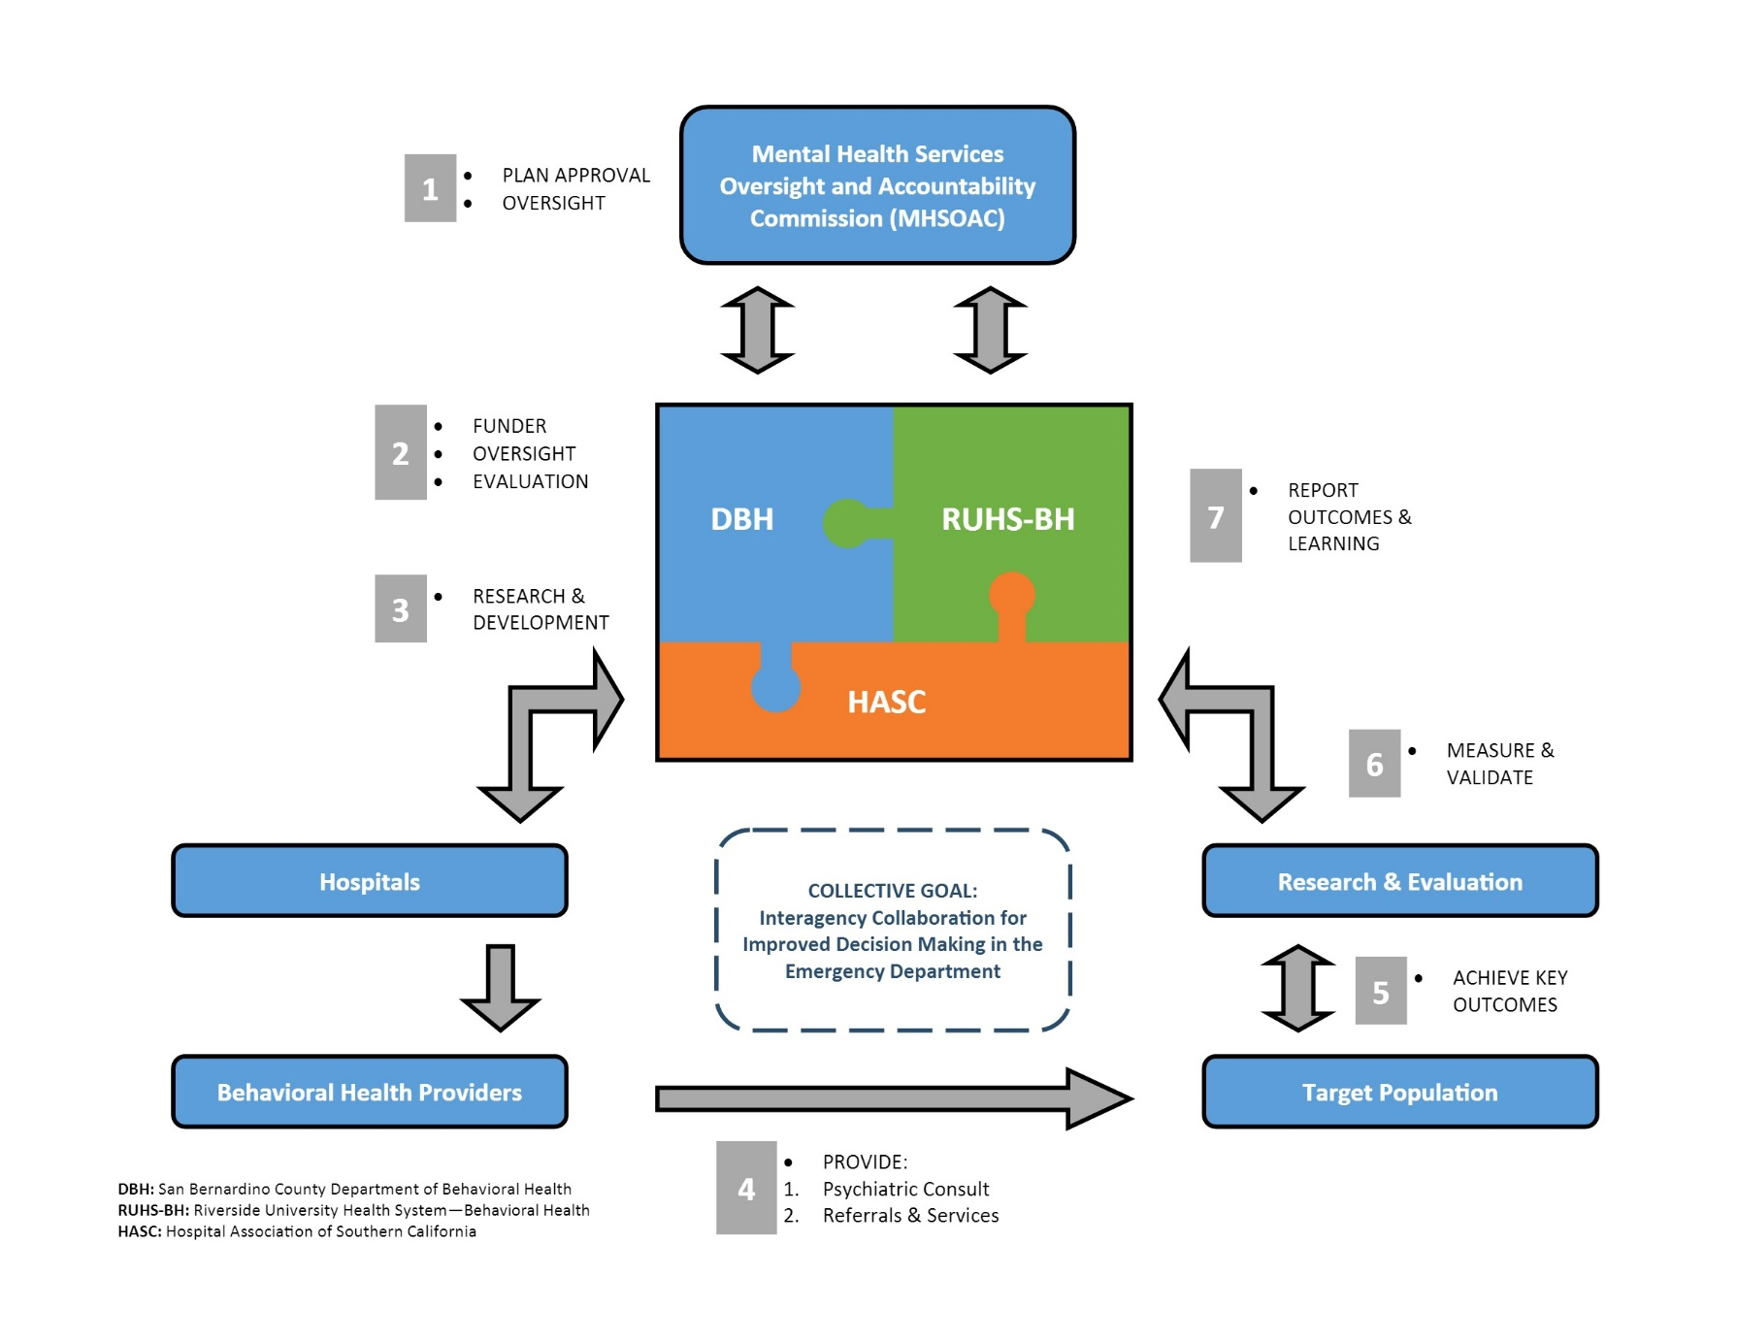
I.E. PsychPartners: Project Flow
Behavioral Health
www.SBCounty.gov

Slide 8
I.E. PsychPartners Milestones
  Establishment and implementation of psychiatric
  workflows/order sets
  Hospital subcontracting established
  Hospital hiring of Behavioral Health nurses/professionals
  Contracting with psychiatric tele health provider
  Training curriculum established and implemented
  Establishment of public/private/non-profit data collection business agreements with appropriate consents
Behavioral Health
www.SBCounty.gov

Slide 9
Evaluation Components
Learning Goal 1: Determine which communication and feedback mechanisms are effective for establishing an Emergency Department (ED) collaborative care process between County MHPs and local hospitals at the systems level.
Expected Outcome: Collaborative care process (Order Set) established at participating hospitals.
Measured by: Hospital policy/procedure and/or documentation on Order Set training, collaborative process feedback survey, focus groups, meeting minutes and observations.
Learning Goal 2: Determine if a collaborative care process in the ED that utilizes telehealth technology expedites psychiatric treatment interventions in the ED, decreases wait times, increases psychiatric services in the ED, and decreases recidivism to the ED.
Expected Outcome: Decreased ED wait times, increased psychiatric services in the ED, decreased recidivism to the ED.
Measured by: ED records/forms documenting the volume of telehealth consultations, ED wait times, disposition at discharge and psychiatric services provided.
Behavioral Health
www.SBCounty.gov

Slide 10
Evaluation Components
Learning Goal 3: Determine if regional training in crisis de-escalation techniques and quality crisis interventions within an ED setting improves ED staff capacity to respond to psychiatric crisis in the ED.
Expected Outcome: ED staff develop and/or improve their crisis intervention and crisis de-escalation techniques, increased effectiveness of behavioral health crisis de-escalation and intervention in the ED (from both staff and consumer perspectives).
Measured by: Training evaluations, consumer experience survey.
Learning Goal 4: Determine if a collaborative care process in the ED that utilizes co-located behavioral health staff increases access to outpatient care.
Expected Outcome: Behavioral health staff access any existing behavioral health treatment plans/history in the MHP’s system to inform the ED collaborative care process and link consumers in the ED to behavioral health community resources, consumers have an increase in use of outpatient behavioral health services.
Measured by: ED records/forms documenting the volume of behavioral health staff cases, number of linkages made, number of outpatient behavioral health services one year pre/post consumer’s first experience with the collaborative care process.
Behavioral Health
www.SBCounty.gov

Slide 11
San Bernardino County - Budget
* Half FY
Behavioral Health
www.SBCounty.gov

Slide 12
Riverside County - Budget
* Half FY
Behavioral Health
www.SBCounty.gov

Slide 13






San Bernardino/Riverside County - Budget
Behavioral Health
www.SBCounty.gov

Slide 14
Questions
Questions & Discussion
Thank you!
Behavioral Health
www.SBCounty.gov

Slide 15
Proposed Motion
Proposed Motion: The MHSOAC approves San Bernardino County’s Innovation Plan as follows:
  Name: Inland Empire PsychPartners: Public-Private Collaboration To Transform Emergency Psychiatric Services (I.E. PsychPartners)
  Amount: $24,124,391
  Project Length: Five (5) Years
Proposed Motion: The MHSOAC approves Riverside County’s Innovation Plan as follows:
  Name: Inland Empire PsychPartners: Public-Private Collaboration To Transform Emergency Psychiatric Services (I.E. PsychPartners)
  Amount: $21,782,701
  Project Length: Five (5) Years
Behavioral Health
www.SBCounty.gov

