Slide 1

NO STIGMA NO BARRIERS
A Transition Age Youth Mental Health Collaborative
Presentation To The
Mental Health Services Oversight and Accountability Commission (MHSOAC)
July 26th, 2018

Slide 2
WHAT IS OUR VISION?
The No Stigma No Barriers Collaborative, guided by transition age youth (TAY) ages 16 to 25, was formed to end stigma towards mental illness and break down barriers to care for young people in California.
We do this through trainings, outreach, and advocacy at the county and state level.

Slide 4
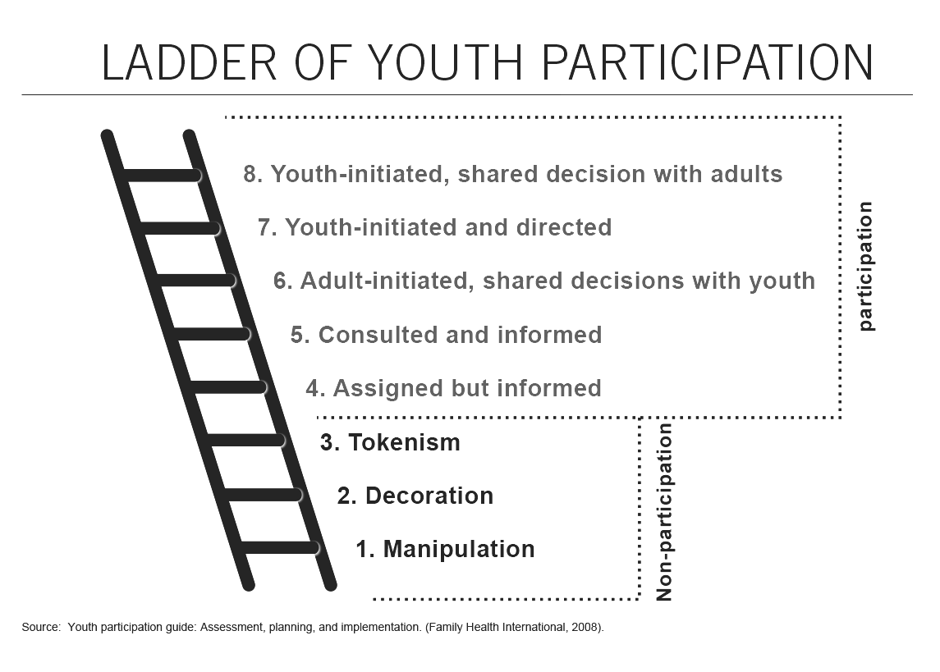
HART’S LADDER OF YOUTH PARTICIPATION
ROGER HART’S LADDER OF YOUTH PARTICIPATION can help adults understand whether they are meaningfully engaging youth.
It’s important to note that the bottom three rungs of the ladder — tokenism, decoration, and manipulation — are NON-PARTICIPATION.

Slide 5
Why does it matter that young people have agency in their leadership?
Young people are advocating for their communities, just like you! Youth are experts in their communities and experiences, and are especially well positioned to observe and address phenomena that are altered by the presence of adults.

Slide 6
Why does it matter that young people have agency in their leadership?
Young people are advocating for their communities, just like you! Youth are experts in their communities and experiences, and are especially well positioned to observe and address phenomena that are altered by the presence of adults.
Youth advocates are also leaders of generational change, and their ability to execute their vision for the future is dependent upon them getting the support — resources, affirmation, skill-building — that they need right now. Intergenerational leadership means collaboratively building a healthier future for all of us, a future that young people especially will have to live in.
The only difference between you and young people is that they lack the structural supports to realize their work. That’s where you can help!

Slide 7
SUPPORTING YOUNG PEOPLE
IN PRACTICE
HOW TO PROVIDE STRUCTURAL SUPPORT
AS ADULT ALLIES

Slide 8
What can authentic youth engagement look like?
Giving youth the agency to determine what they want and need to develop as leaders and professionals.
Asking youth what they want to achieve as part of your organization. What motivates them to continue?
  For example, today we have prepared this presentation we all are passionate about and want to see grow for other youth.
It is important that youth be informed, empowered and uplifted.

Slide 9
How can you support youth?
Resources to develop their visions.
Stay informed and refer to a handy tool like Hart’s Ladder to avoid falling back into old practices that harm youth.
What rung of the ladder is your organization currently at?

Slide 10
Trauma & Harm
In the Advocacy
Field
The harm that is caused often keep youth from engaging in important ideas.
  My own personal experiences in organizational harm are just a few examples that you can avoid.
Many youth who step into the mental health advocacy field have past trauma and mental health struggles that are not considered, and often times working in this field is even more traumatizing.
Youth that experience “advocate burnout” are often being actively tokenized.

Slide 11
What rung of the ladder is your organization currently at?
Are you comfortable where you are in engaging youth?

Slide 12
Authentic youth engagement is the
foundation to building confident
youth leaders.

Slide 13
Youth Engagement: What does it look like?
“Actual youth at the table! Speaking, engaging, and leading the conversations as we are the experts!”
“Trust, power-sharing, equity and opportunity!”
“Connection and community”
“Allowing pride to decrease to create and improve rapport with the youth in order to build community and safe spaces for them. Allowing the youth to be their authentic selves and not questioning whatever that looks like.”
“Giving the youth a comfortable environment to feel secure in their role as a youth, while teaching them how to speak and advocate well enough so they can transfer those skills to new youth, so they can ultimately become professionals.”

Slide 14
Generational Gap: How do you connect the dots?
Scenario: “You are thinking about setting up a mental health summit. You have to reach out to Generation Z, Millenials, and Baby Boomers. How will you get your message across?”
Reaching out examples: Email, Newsletters, Phone, Social Media
Possible Tactics: Fidgets, Music, Visuals

Slide 15


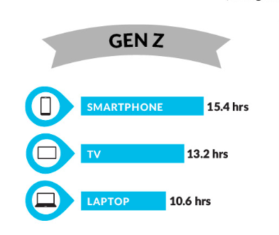
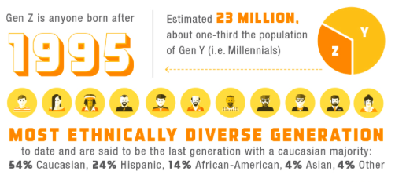

Slide 16



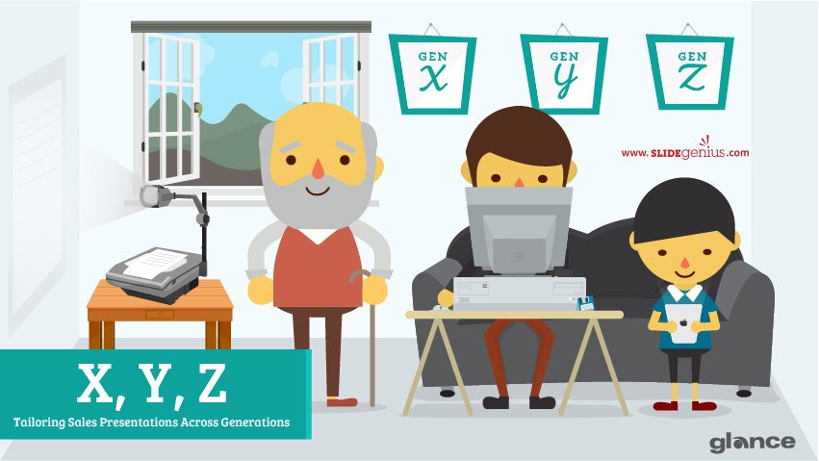
Think about what major events shaped your particular generation?
1.Traditionals
2.Baby Boomers
3.Generation X
4.Millennials
5.Generation Z

Slide 17
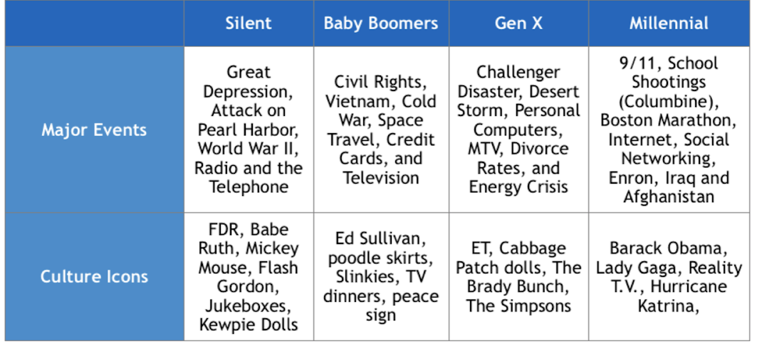

Slide 18
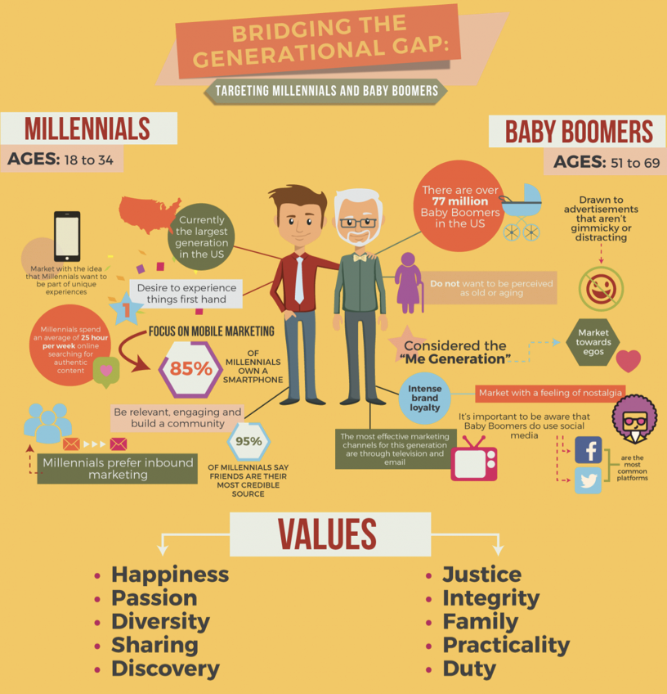

Slide 19
Power Continuum
•No youth participation: Unchallenged authority of adults.
•Tokenism: Adults set agenda and make decisions. One or two young people may be included, but often without training and without a promise that their suggestions will be taken.
•Consultation: Adults seek advice from young people, but on terms set by adults.
•Representation: A select number of young people are put forward as representing their peers, usually via a committee system and with varying degrees of accountability.
•Mentoring: Adults provide encouragement and impart skills/values to help a young person achieve success.
•Partnership: Young people and adults set agenda together, decide on issues and activities, and have joint accountability and shared responsibility.

Slide 20
ENGAGING YOUTH
through Trainings, Outreach, & Advocacy
Trainings
Statewide and Local
  CMHACY, NAMI, CYC regional council meetings, summit
Youth developed curriculum
Youth led workshops and trainings and events
Outreach
Youth friendly/designed outreach materials
  Youth Survey, factsheets
Social Media
Blogs, Videos
Advocacy
Topics: Stigma as a barrier, education and mental health
Statewide and local
Elevated youth voice

Slide 21
GET INVOLVED
JOIN US
Contact us at: info@nostigmanobarriers.org
Visit our website at www.nostigmanobarriers.org starting
Sign up for our newsletter at: calyouthconn.org/youth-mental-health

